Slide 1
MULTI-TABLE QUERIES
Week 4 Chapter 7 Video 2
Complex JOINs
Dr. Anne Powell

Slide 2
Agenda
Complex Joins (more than 2 tables)
In-Class practice

Slide 3
Complex Joins of more than 2 tables
While the examples given thus far have joined rows from two tables, you can specify up to 16 tables in a JOIN operation.
The more tables that are included in a JOIN operation, the longer the query will take to process, especially when the tables are large with millions of rows per table.

Slide 4
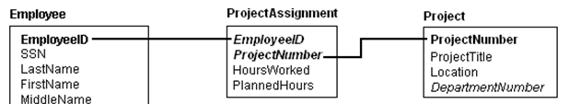
Complex JOIN
What about those associate entities that connect to two tables at the same time?
FROM Employee e JOIN ProjectAssignment a
ON (e.EmployeeID = a.EmployeeID) JOIN Project p
ON (a.ProjectNumber = p.ProjectNumber)
Or:
FROM Employee e, ProjectAssignement a, Project p
WHERE e.employeeID = a.employeeID AND a.projectNumber = p.projectNumber

Slide 5
Joining Three Tables
The SELECT statement to join the tables depicted in the figure is shown here.
/* SQL Example 7.16 - Join conditions in the FROM clause */
COLUMN "Raised Salary" FORMAT $999,999;
SELECT LastName "Last Name", FirstName "First Name",
1.10*Salary "Raised Salary", p.ProjectTitle "Project"
FROM Employee e JOIN ProjectAssignment a
ON (e.EmployeeID = a.EmployeeID) JOIN Project p
ON (a.ProjectNumber = p.ProjectNumber)
WHERE p.ProjectTitle LIKE 'Child Care Center';
Last Name First Name Raised Salary Project
--------------- --------------- ------------- -----------------
Eakin Maxwell $16,500 Child Care Center
Adams Adam $6,050 Child Care Center
Simmons Lester $24,200 Child Care Center

Slide 6
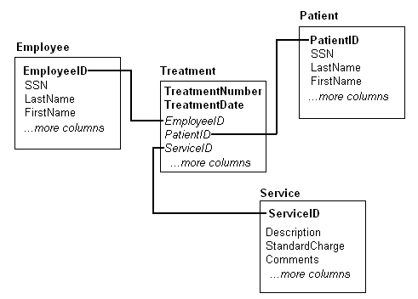
Joining Four Tables

Slide 7
Joining Four Tables using FROM
/* SQL Example 7.18 - Join conditions in the FROM clause */
SELECT p.LastName || ', ' || p.FirstName "Patient Name",
s.Description "Treatment",
e.LastName "Med Employee"
FROM Patient p JOIN Treatment t ON (p.PatientID = t.PatientID)
JOIN Employee e ON (e.EmployeeID = t.EmployeeID)
JOIN Service s ON (s.ServiceID = t.ServiceID)
WHERE e.LastName = 'Quattromani'
ORDER BY p.LastName, p.FirstName;
Patient Name Treatment Med Employee
------------------------- -------------------- ---------------
Ridgeway, Ricardo EKG/Interp Quattromani
Ridgeway, Ricardo Therapeutic Inj Quattromani

Slide 8
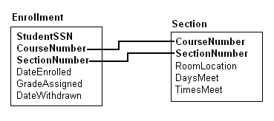
Joining Tables by Using Two Columns
The diagram depicts the relationship at a university where students enroll in course sections.

Slide 9
Joining Tables by Using Two Columns
The SELECT statement that accomplishes the JOIN based on two columns is shown below.
This situation arises when the related tables have composite primary key columns.
/* SQL Example 7.19 */
/* Join conditions in the WHERE clause */
SELECT s.CourseNumber "Course", e.StudentSSN "Student SSN",
s.RoomLocation "Room"
FROM Enrollment e, Section s
WHERE e.CourseNumber = s.CourseNumber AND
e.SectionNumber = s.SectionNumber;
/* Join conditions in the FROM clause */
SELECT s.CourseNumber "Course", e.StudentSSN "Student SSN",
s.RoomLocation "Room"
FROM Enrollment e JOIN Section s
ON (e.CourseNumber = s.CourseNumber) AND
(e.SectionNumber = s.SectionNumber);

